Slide 1
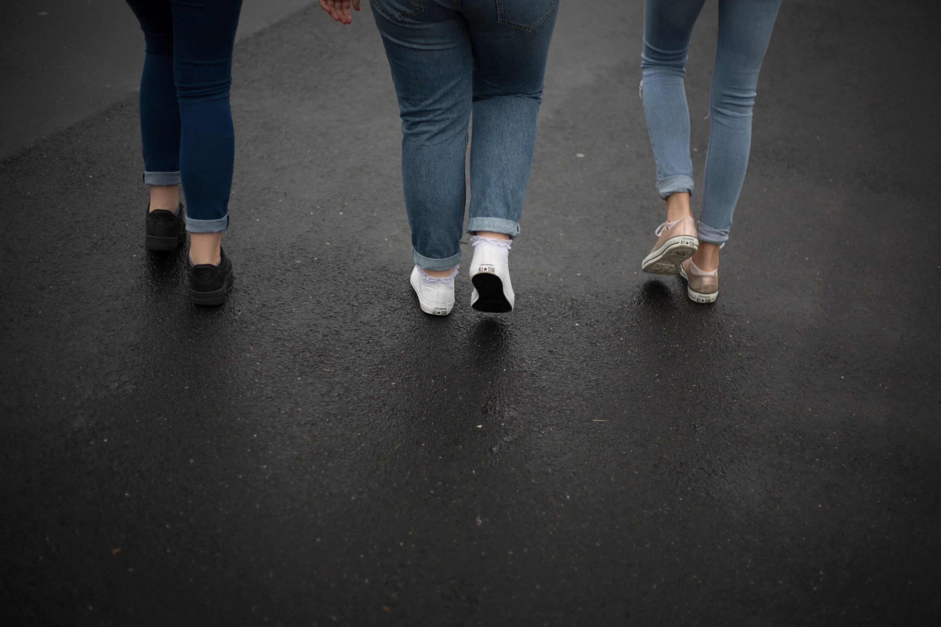
When rights are denied
poverty in the UK
Unicef/Sutton-Hibbet
Notes:
Our Seen and Heard resource that explores issues around poverty in the UK is available here: unicef.org.uk/rights-respecting-schools/seen-and-heard-secondary-school-resource/here

Slide 2
The right to an adequate standard of living
Article 27
Every child has the right to a standard of living that is good enough to meet their physical and social needs and support their development.
Governments must help families who cannot afford to provide this.
Notes:
Presentation: The text on the slide is a summary of Article 27. You may wish to discuss what elements go to make an adequate standard of living.

Slide 3
The right to an adequate standard of living
Almost 4 million children live in poverty in the UK and, as a result, their life chances suffer.
For example, they are over three times more likely to experience mental health problems than their more affluent peers.
Notes:
Video: This video was made by students at St Kentigern's Academy, Scotland in 2012 in response to their concerns about child poverty.
If the embedded video doesn’t play, you can view it here: https://www.youtube.com/watch?v=V8cNpUMvAwg
Presentation: The Unicef UK ‘Seen and HEARD’ video (approximately nine minutes) is a powerful account based on the real experience of 12 year old David and the impact that living below the poverty line has had on his life. The video was made in 2012 by students of St Kentigern’s Academy in Scotland which is a Level 2 Unicef UK Rights Respecting School. If time is available, a discussion with students after showing the video would provide an excellent opportunity to further explore how children and young people’s rights in the UK are being denied.

Slide 4
Reflection
Some of Us
“Some of us need help, though you don’t realise.
“You can’t hear it, you don’t see it ‘til you look into their eyes.
“Some of us need help, you need to hear our voice.
“If you hear it, you can change it, you can give us the choice.”
By Kirsten MacDonald
Notes:
Music: If the link above does not work the song ‘some of us’ can be found here: unicef.uk/seen-and-HEARD-soundtrack
Presentation: The lyrics are from part of a song ‘Some of us’ that features in the video and which has been written by a student from St Kentigern’s Academy. It is suggested that the soundtrack to the song is played with the slide being shown at the same time.

