Slide 1
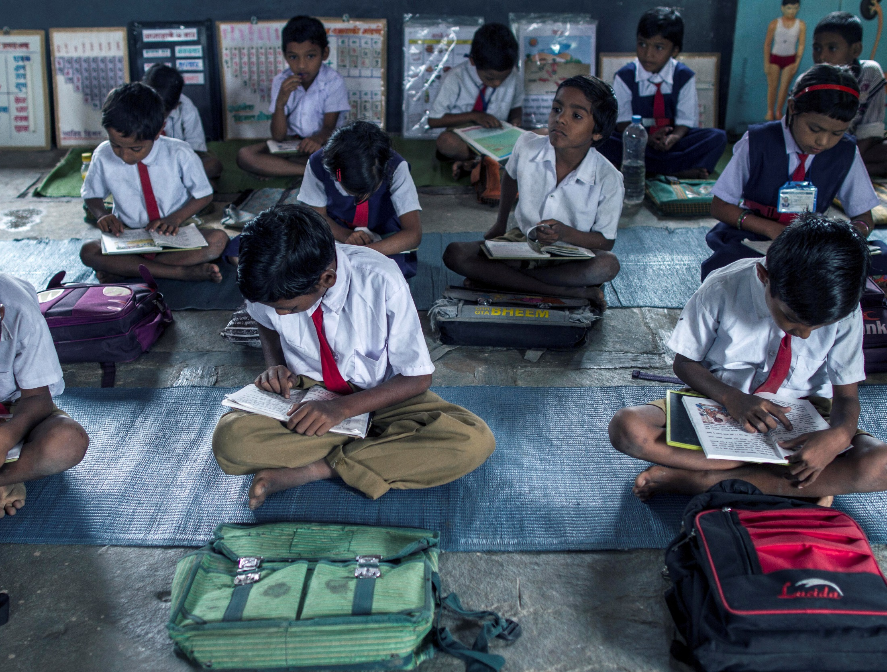
The right to education
© UNICEF/UNI173761/Altaf Qadri
© Unicef/Singh
Notes:
Village Chincholi, Ghatanji Block, Dist. Yavatmal, Maharashtra, INDIA. Students attend their class at The Zilla Parishad Primary School in Chincholi Village. The Right to Education Act, which was brought into effect in Maharashtra in 2010, guarantees the right to free and compulsory education for all children up to the age of 14 years.
But it is not enough for a child to be enrolled in a school and present in a classroom if he/she is out-of-school in his/her mind and heart. UNICEF has teamed up with MPSP to ensure that every child in Jalna, Wardha and Yavatmal is not only literate but educated, through the programme Let’s Make Our School Child-Friendly.
A Child-Friendly School (CFS) is simply one that children want to come to and enjoy studying in. As part of the programme, UNICEF organises training workshops for school heads and teachers in the three districts and shares new ideas and techniques on making learning a more interactive experience, keeping children engaged without the stress of punishment and evaluations.

Slide 2
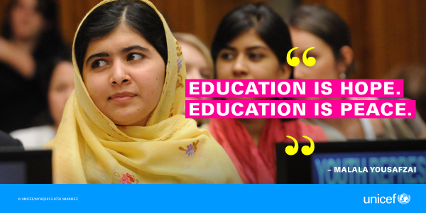
The right to education
Every child has the right to an education.
Primary education must be free and different forms of secondary education must be available to every child.
Discipline in schools must respect children’s dignity and their rights.
Richer countries must help poorer countries achieve this.
Notes:
Presentation: Useful to re-cap the first assembly with students in which they learnt about the UNCRC. The focus of this assembly is 'the right to an education' and the text on the slide is a summary of Article 28. You may wish to discuss elements of the text in more
detail. Article 29 (not cited on the slide) references the goals of educations.

Slide 3
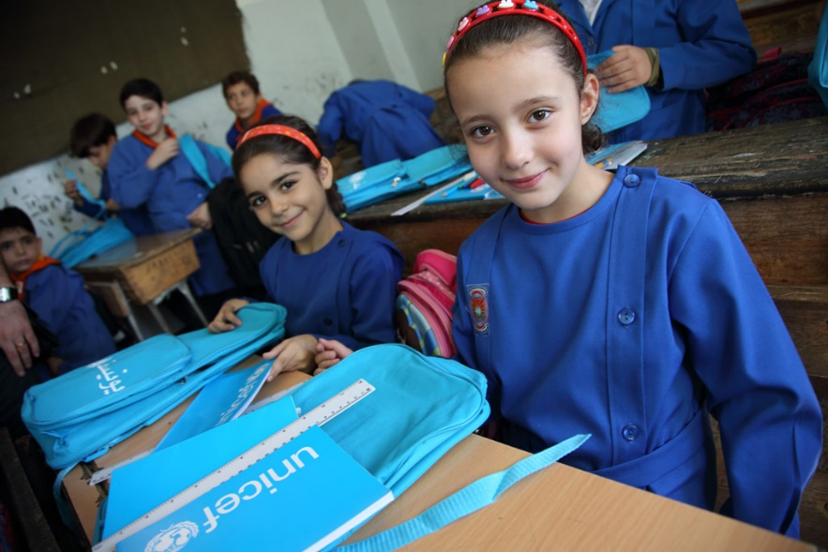
The right to education
Based on 2013 estimates:
93% of primary school aged children in the world are enrolled in school. The remaining 7%, almost 56 million, are not.
About two thirds of secondary school aged children in the world are enrolled in schools, in the least developed countries it is only a third.
© Unicef/Sonoda
Notes:
Image: On 16 September 2014 in the Syrian Arab Republic, girls in Grade 3 sit with the school bags and stationery supplies they have just received at their school in central Damascus, the capital. The bags and supplies bear the UNICEF logo. The country’s schools reopened on 14 September. To encourage children to return to learning, UNICEF launched a national media campaign to raise public awareness about the importance of education and convey key information on school registration. The campaign’s messages were disseminated through such methods as a short radio programme, mobile Short Message Service (SMS), billboards, posters and flyers. UNICEF and partners also distributed school bags with essential stationery supplies to 1 million conflict-affected primary-school-aged children in nearly 300 sub-districts in all 14 governorates.
Presentation: The data raises several points which could be explored with the students. For example, imagine that only two thirds of the students in the school were able to access secondary school education, how will the other students feel about this and what would be the longer term implications for an individual, their family and wider society? Alternatively, you may prefer to ask the question ‘what percentage of the world’s primary aged children do you think are enrolled in school?’ before giving the answer.

Slide 4
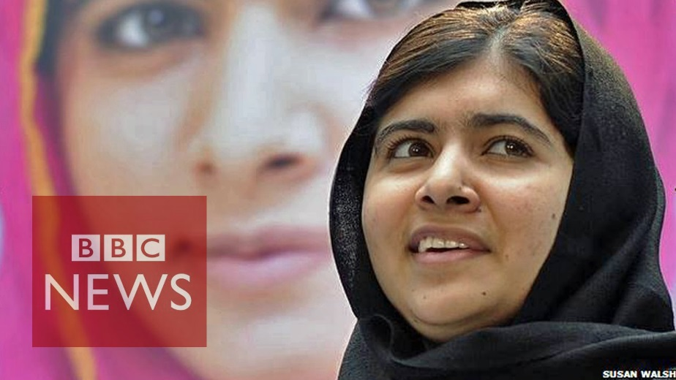
The right to education
"In some parts of the world, students are going to school every day. It's their normal life. But in other parts of the world, we are starving for education... it's like a precious gift. It's like a diamond…"
Malala Yousafzai
Click to play Malala’s story
Notes:
Video: If embedded video does not load please find here: https://www.youtube.com/watch?v=FnloKzEAX7o
Presentation: The story of Malala Yousafzai and how she bravely fought for the right to have an education (video clip from the BBC, approximately three minutes).

Slide 5
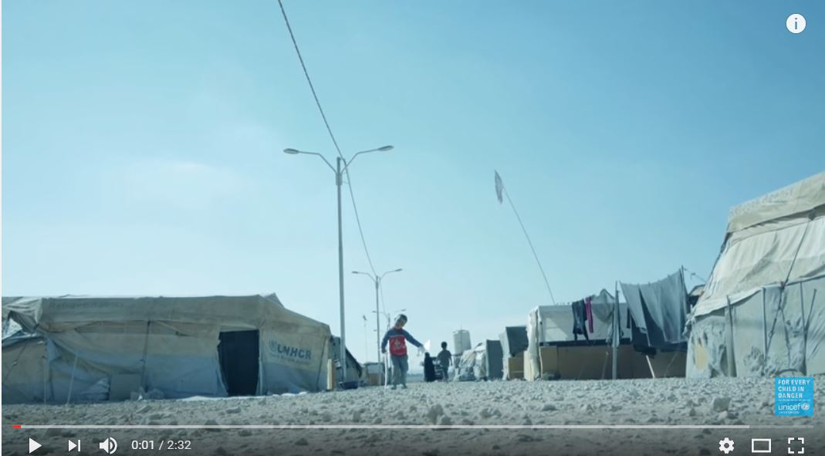
Reflection: What does education mean to you?
Notes:
Video: If embedded video does not place please find here: https://www.youtube.com/watch?v=Un5msddQl6U
Presentation: Play the video clip (approximately two minutes) and draw upon this to ask students to share their thoughts about what education means to them.

