Slide 1
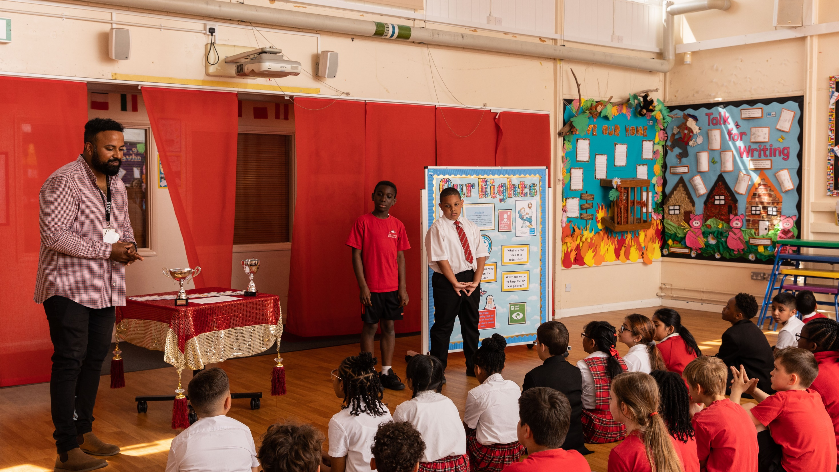
© UNICEF/Dawe
SAFEGUARDING
CAMPAIGNING IN SCHOOL
Notes:
Image credit: UNICEFUK/Dawe

Slide 2
CONTENTS
For each slide, please look at the presenter notes for delivery information.
Slide 3: Aims of the Session
Slide 4: Ways to use this pack
Slide 5 : Introducing this month’s Spotlight
Slide 6: Links to RRSA Outcomes
Slide 7: Links to Articles
Slide 8: Case Study – Eastbury Community School
Slide 9: Case Study – Longstone Special School
Slide 10: Let’s Discuss
Slide 11: Activities
Slide 13: Conference 2023: Safeguarding and tackling child-on-child abuse through the framework of children’s rights
Slide 13: Resources
Notes:
For each slide, please look at the presenter notes for delivery information. You may wish to amend or delete this slide when you deliver the session in your school.

Slide 3
AIMS OF THE SESSION
To consider how to use the UN Convention on the Rights of the Child framework to strengthen and support your safeguarding work. ​
To consider how rights language can strengthen your safeguarding culture for both rights holders and duty bearers.
Notes:
Presenter notes: Please edit the aims of the session to suit the time you have available for your session. ​
​
This session is intended to support you in supporting staff to develop their understanding of what safeguarding is, and how it should be underpinned by articles to support your journey as a school. . ​
​

Slide 4
WAYS TO USE THIS PACK
DELETE THIS SLIDE BEFORE USING
If your time is tight, use the introduction slide and choose from the key discussion questions to explore with your colleagues.
If you have longer, you can also choose some of the activities to explore.
You may wish to cover the content over several staff meeting sessions.
There are trainer notes for each slide – please do have a look at these for further guidance.
There
Notes:
Delete this slide before using.
It would be useful to have copies of the summary CRC so that staff can refer to them throughout the session.
www.unicef.org.uk/wp-content/uploads/2019/10/UNCRC_summary-1_1.pdf

Slide 5
SPOTLIGHT ON…
Often when we hear the word ‘safeguarding’ we can think of compliance, in policies, in training, in reporting mechanisms. But thinking about safeguarding in the context of children’s rights helps it to come alive - so we can better embed a culture of safety and care in everything we do. ​
We know when children feel safe, they can build stronger relationships with friends and trusted adults, they can be bold creatively and academically, all of which is setting them up for a bright future.
Chloe, UNICEF UK Safeguarding Specialist introduces this month’s Spotlight.
Notes:
The video complements the content of this pack and can also be used separately. ​
​

Slide 6
LINKS TO RRSA OUTCOMES
Strand B: TEACHING AND LEARNING THROUGH RIGHTS
Outcome 4: Children and young people are safe and protected and know what to do if they need support.
Notes:
Presenter notes: ​
This spotlight pack has links to Strand B: Teaching and learning THROUGH rights, in particular, Outcome 4 where children and young people feel safe and protected and know what to do if they need support. This should be linked to any safeguarding work that you do. ​
​The full text of the Strands and Outcomes of the Award can be found here:​​
www.unicef.org.uk/rights-respecting-schools/wp-content/uploads/sites/4/2015/06/RRSA-Strands-and-Outcomes-at-Silver-and-Gold-1.pdf

Slide 7
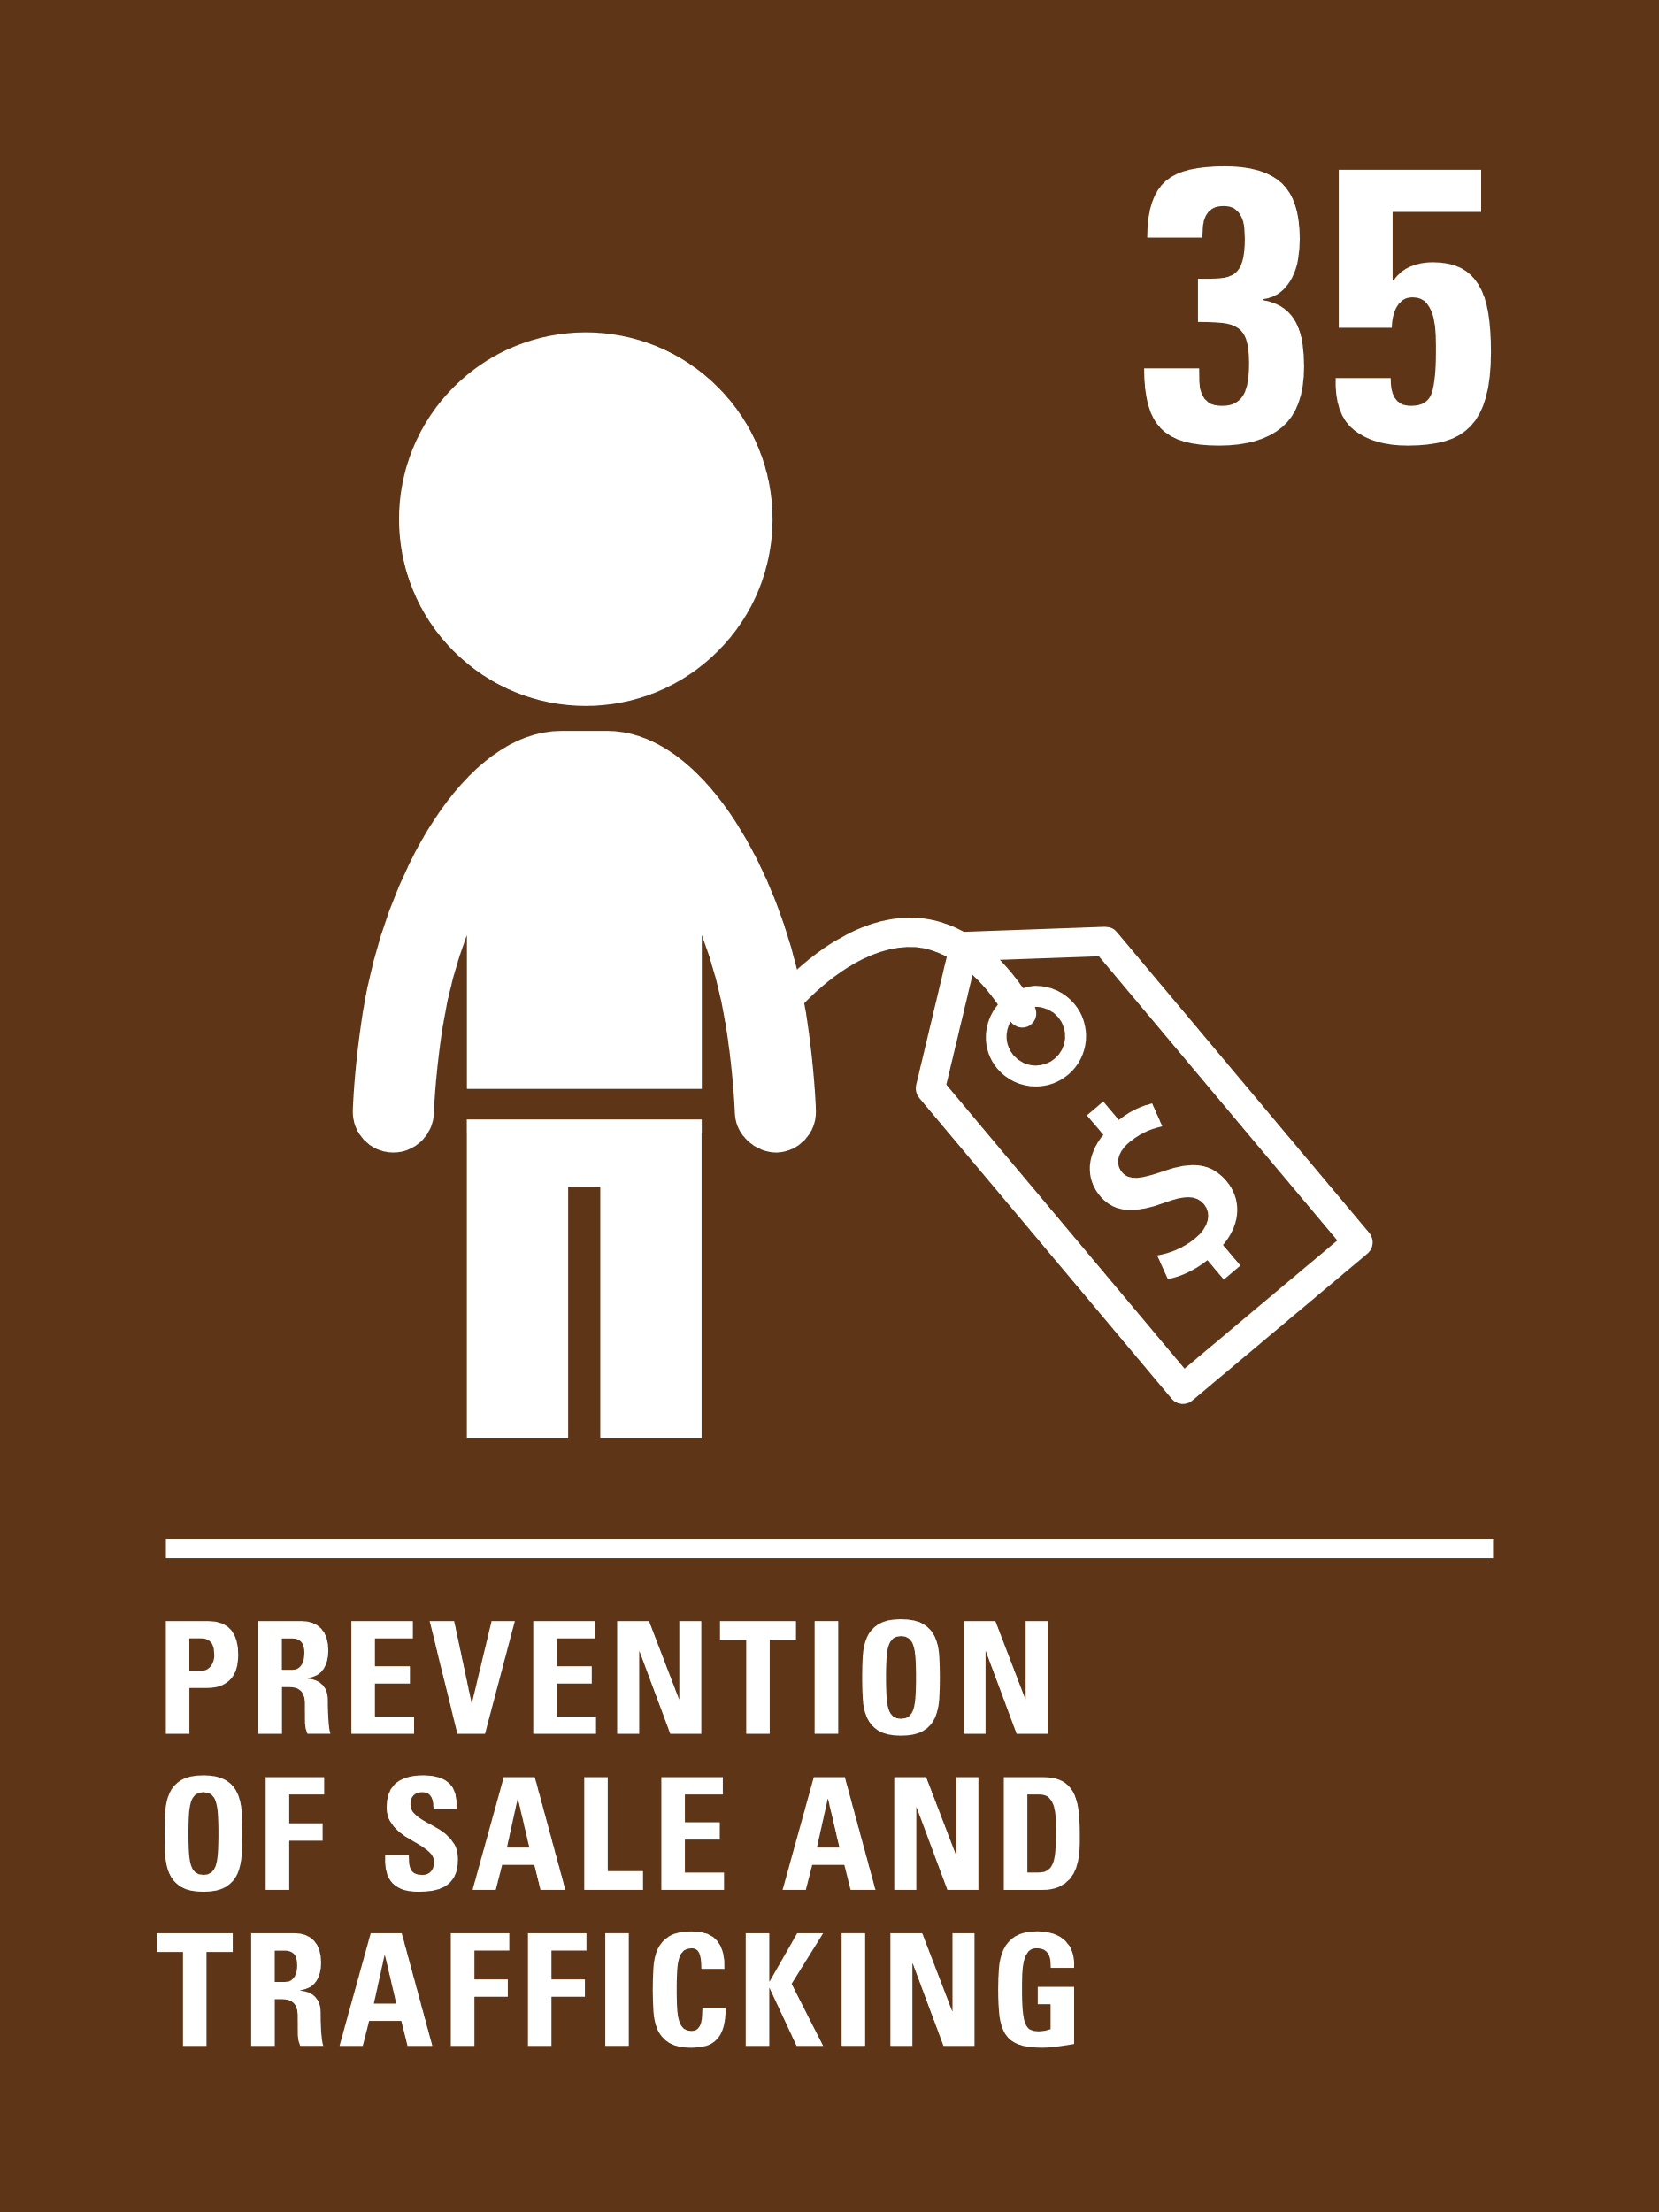
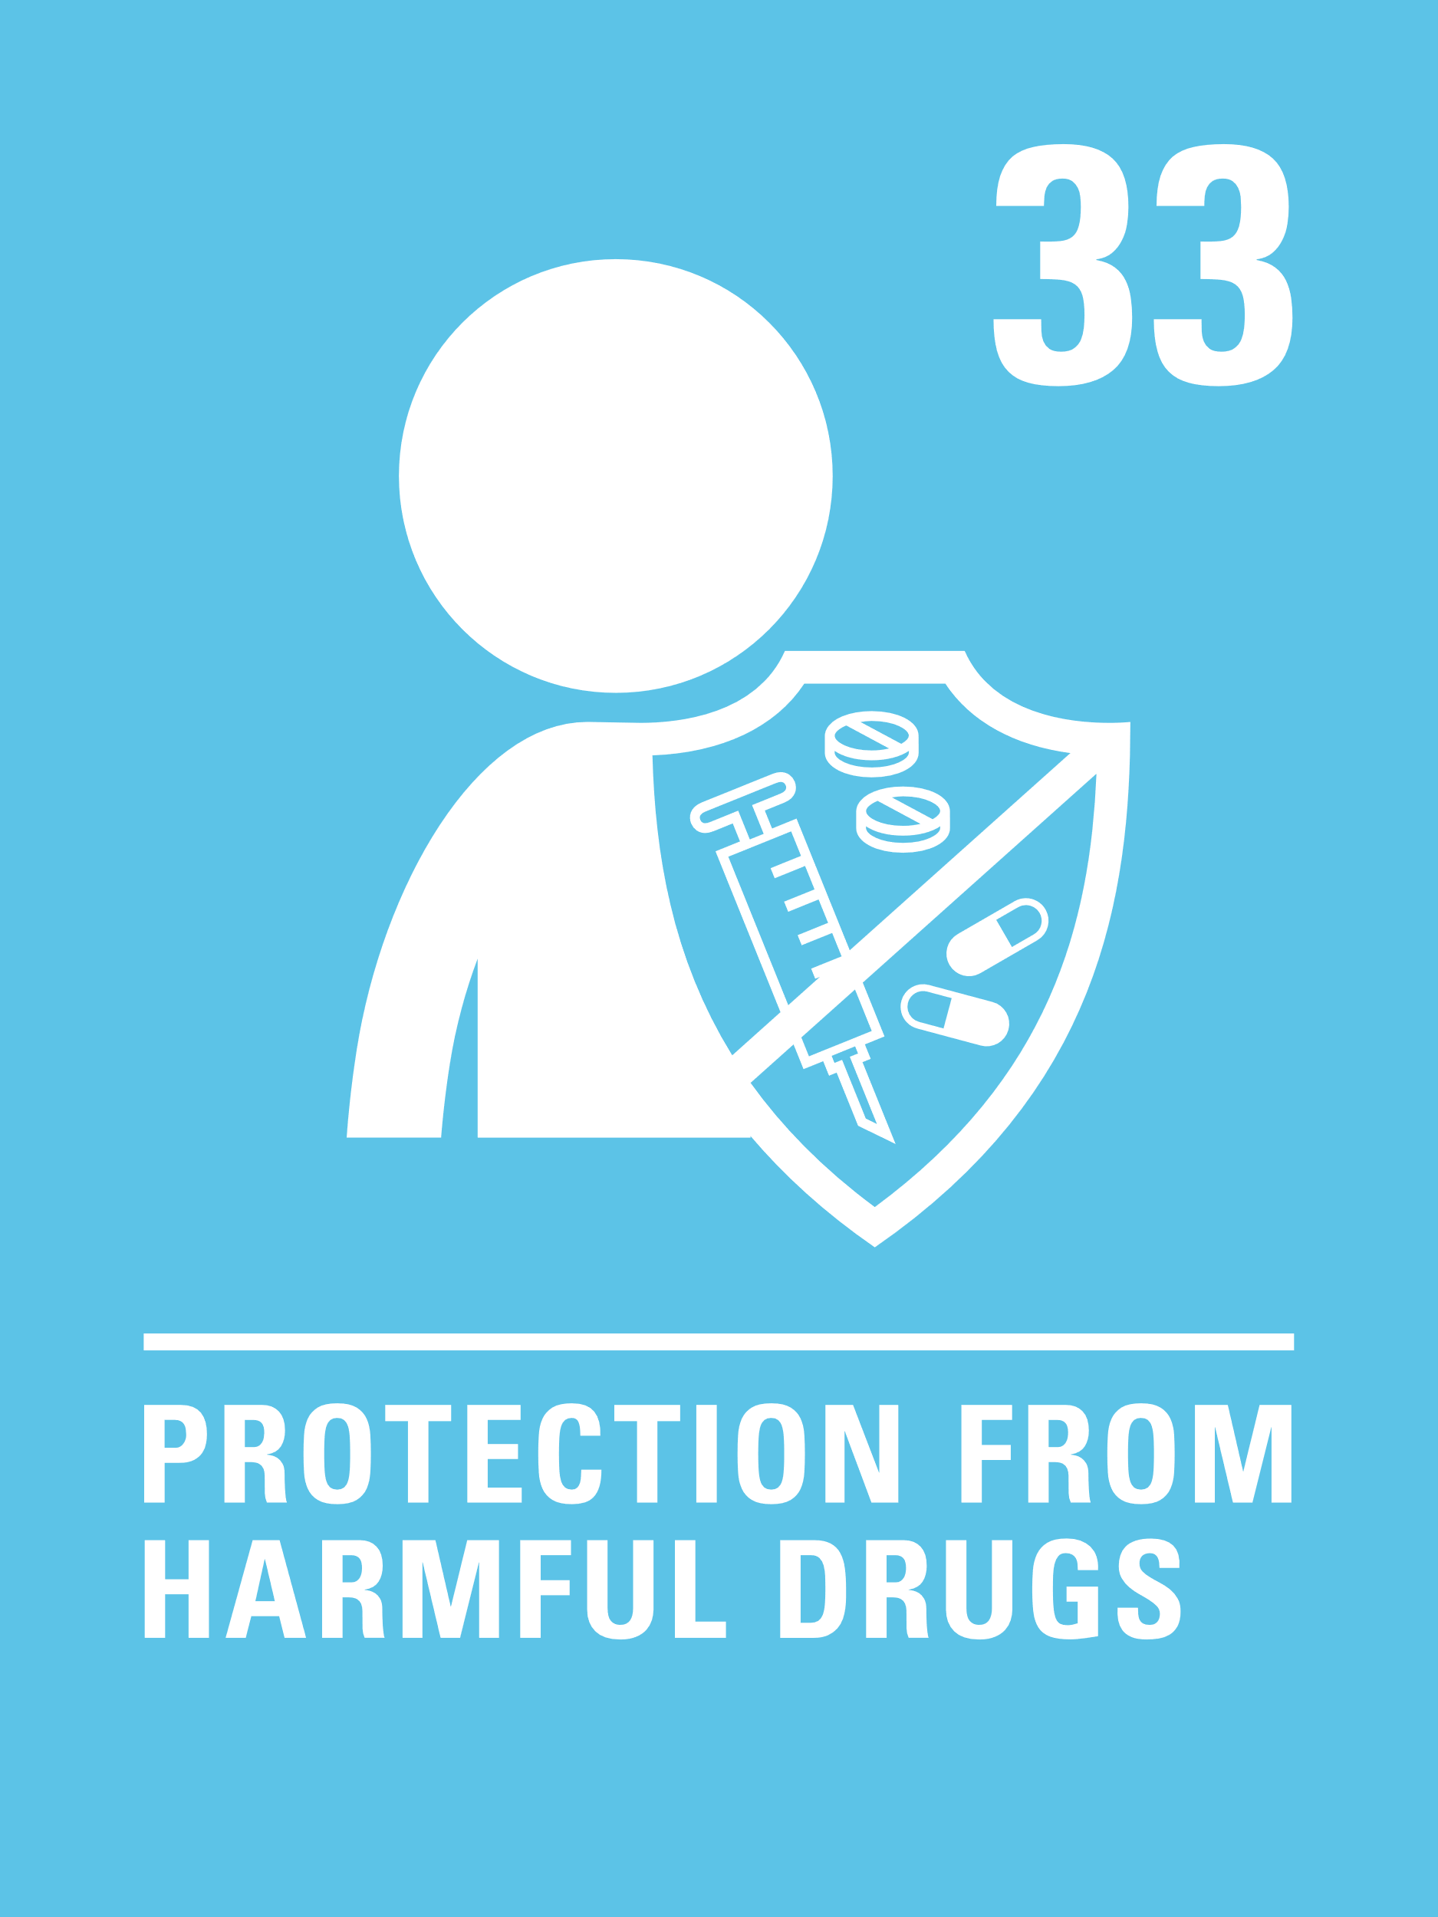
LINKS TO ARTICLES
Look at the summary of the CRC with a partner – which articles do you think are particularly relevant to our work on Safeguarding?
When ready click to reveal.
Notes:
Presenter notes: When showing this slide in presenter mode the articles will appear on click. ​ ​
Look at the summary of the CRC with a partner – which articles do you think are particularly relevant to our work on safeguarding? Give good time for people to think about and discuss the links. Your colleagues may identify different articles to the ones displayed. If time permits, encourage staff to explain their choices. ​
Think about what Chloe talked about in the video - There are lots of rights in the United Nations Convention on the Rights of the Child that relate to safeguarding: Article 19, which states that children have the right to be protected from all forms of violence, abuse, neglect and bad treatment, Then there are Articles 32-38, which talk about every child’s right to be protected from sexual abuse, trafficking, labour, illegal use of drugs, other forms of exploitation, detention, and conflict. ​​
The General Principles are also important in safeguarding - Article 2: non-discrimination, reminds us that every child, whatever ethnicity, gender, religion, language, ability, disability, their family background – whatever is going on in their life outside of school, our biggest hope is that they would walk into our school and just know they are safe – and know that every adult is doing their part to build that friendly, inclusive, safe culture, and as in Article 12, a place where their voice is heard in all matters that impact them, with their views taken seriously. ​​
CRC Summary: unicef.uk/CRC_Icons

Slide 8
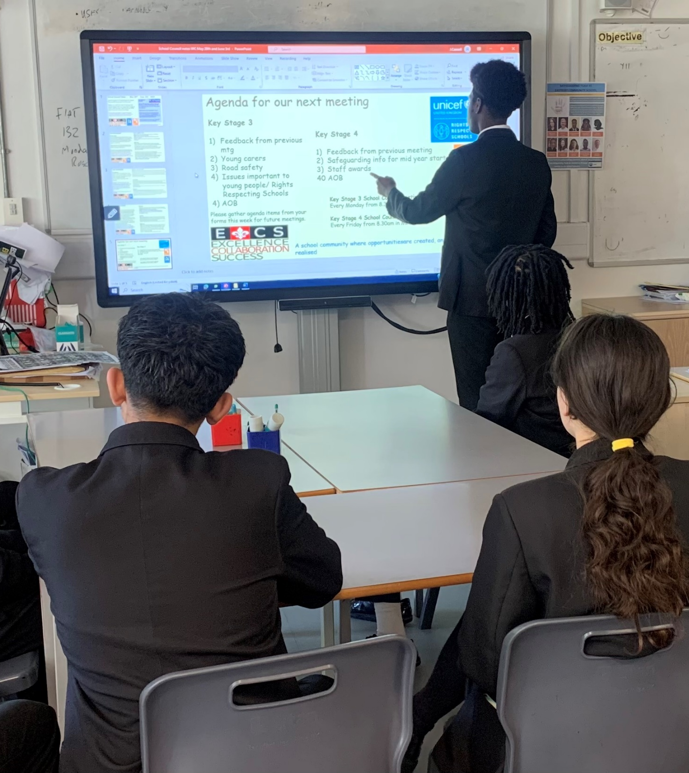
Young people discuss safeguarding at an RRSA Steering Group meeting.
CASE STUDY
Look at this case study Eastbury Community School.
Read the full case study online.
​​​​​All members of our school community know that safeguarding is everyone’s responsibility with a shared commitment to Article 3: best interest of the child. Safeguarding is evident throughout school life from displays in corridors and classrooms through to assemblies and tutor time activities, staff training and the PSHE education programme.
​Students in leadership roles receive training and support to contribute to a safe learning environment. Peer mediators and the mental health ambassadors are available to mentor students in and outside the classroom. Students genuinely care about equality and rights, and recognise their role in ensuring all members of our community are treated with respect and dignity.
Listening to students has been key to strengthening safeguarding. Asking for student’s feedback and ideas means they are invested in making new initiatives work, they spread awareness and challenge misconceptions.
Notes:
The full case study is available on the RRSA website, where you can print it out and share with your colleagues if you are choosing to focus on this as part of your session.

Slide 9
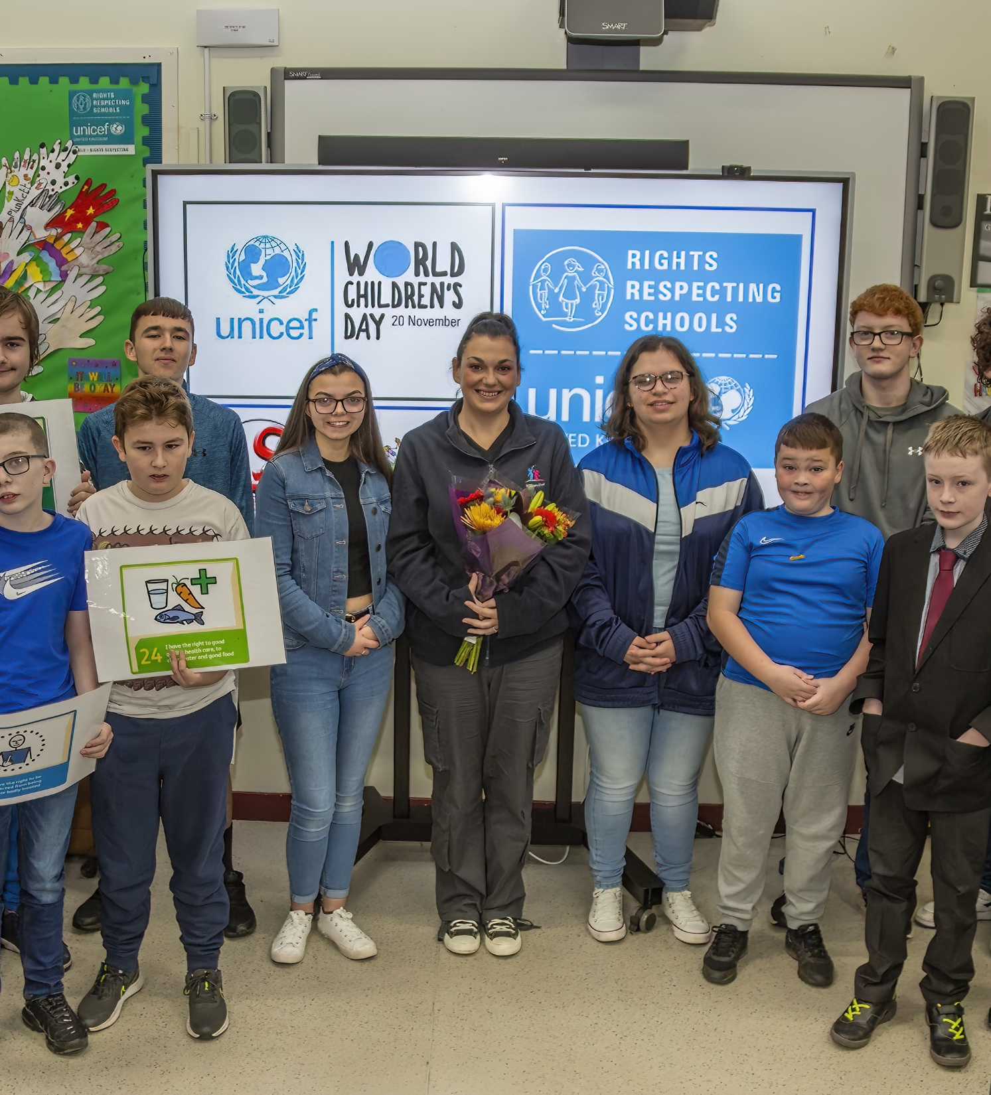
Young people on the RRSA Steering Group celebrate World Children's Day.
CASE STUDY
Look at this case study from Longstone Special School
Read the full case study online.
​​​​​​​A highlight of our week in Longstone is always our Rights Respecting Assemblies. This is a really useful way to raise the profile and increase the awareness of our Preventative Curriculum which encompasses both the formal and informal aspects of safeguarding in our school.
​The impact of RRSA can’t always be measured. It is a feeling within the school of pupils knowing they are cared for; they trust that adults will act on any concerns or worries that they have.
The pupils also designed ‘What’s Strong with You’ posters that identified Safeguarding Staff and displayed these around the school. School Council representatives completed leadership training and took an active role in the development of the project, they themselves reported an increase in self-confidence from knowing they made a real difference to school life and other pupils benefitted from the knowledge they shared in the video and the awareness they raised of safeguarding procedures in our school.
Notes:
The full case study is available on the RRSA website, where you can print it out and share with your colleagues if you are choosing to focus on this as part of your session.

Slide 10
LET’S DISCUSS
2. Rights Respecting Schools often report that safeguarding disclosures can increase as children develop their knowledge of rights. Discuss why this may be the case. This resource can help us think how we can link Safeguarding and rights more closely.
1. Do children in our school understand the work we do on safeguarding within the context of rights? How could we strengthen our understanding that keeping them safe is enshrined within the CRC?
3. How can we ensure the dignity of children is preserved when supporting them through a safeguarding issue?
Notes:
Presenter notes: Choose the questions that are most relevant to your setting and experience. Collect some of the ideas from your colleagues and add them to your action plan/evidence.
1: Reflect on the way you explain safeguarding to children and young people. Are you linking this work directly to articles? Do you explain WHY you have safeguarding procedures in place and link these to the articles mentioned previously in this PowerPoint.
2: Reflect on the children and young people in your setting. Children in your care may be living in conditions where they are not able to enjoy all of their rights all of the time. Many schools report that gaining this knowledge of rights has been the catalyst for children realising this. Think about your safeguarding procedures and how you are preparing for this within your setting.
3: Reflect on what dignity means to you as a staff. Where will children experience their dignity being upheld within your safeguarding practices? Where might your children and young people feel that they are not being treated in a dignified manner? Think about external agencies you work with and how they operate within your setting. Could this be an area to explore?

Slide 11
ACTIVITIES
In groups, draw a Rights Respecting classroom onto large pieces of flipchart paper. What do you see, hear and feel in a Rights Respecting classroom?
1. As a team lets look at our Safeguarding policy and processes. Are links to rights made explicit? Consider how we can strengthen this. Do we have a child friendly version of this policy?
2. How can we ensure children are clear about what to do if they have concerns? ​
Look at the list of suggestions from other Rights Respecting schools.
3. Consider how we can make sure that visitors to our school are aware of and play an active role in supporting our policy and procedures on how to keep children safe.
Notes:
Presenter notes: There are three suggestions for activities. Depending on the time you have available, choose one or more activities for your colleagues to work on together to further explore the topic. Different groups could explore different activities. The activities that you do not wish to use can be deleted.
1.Give out copies or have one copy on a screen of your current safeguarding policy. As you read through it, think of where you can make explicit links to articles i.e. could you add explicit links to Article 12 when detailing the procedures for children reporting incidents to duty bearers.
2. Think about signage and displays around your school. Are you displaying visual images of the staff who are responsible for safeguarding. If not, could this be created so that children and staff know the chain of adults to report any incidents to. Look at the list attached and discuss if any of the suggested ideas could be developed at your school.
3.Do you ask all visitors to look at your safeguarding policy? Do you have mechanisms in place for this to be incorporated into your signing-in process? Could you include safeguarding key points on visitor lanyards or visitor badge print-outs? Are there explicit links to Articles in this information? Have you included this information in your safeguarding policy?
​

Slide 12
RRSA Conference 2023 – Session on Safeguarding and Children’s Rights
Safeguarding and tackling child-on-child abuse through the framework of children’s rights with Sarah Lancaster, Head of Safeguarding at UNICEF UK Marielle Burgess and Jenni Girling from Comberton Village Collage.
Notes:
Presenter notes: This example is from a secondary setting. This session was recorded as part of the UNICEF UK Rights Respecting Schools Award Online Conference in October 2023.
Safeguarding and tackling child-on-child abuse through the framework of children’s rights with Sarah Lancaster, Head of Safeguarding at UNICEF UK Marielle Burgess and Jenni Girling from Comberton Village Collage. Session introduced by Katelyn Farrenson, RRSA Professional Adviser
You can read more about Comberton Village Collage's work in this area here: www.sec-ed.co.uk/content/best-practice/tackling-child-on-child-abuse-a-case-study/
Find out more about our latest RRSA conference: https://www.unicef.org.uk/rights-respecting-schools/about-us-new/rights-respecting-schools-award-conference-virtual/

Slide 13
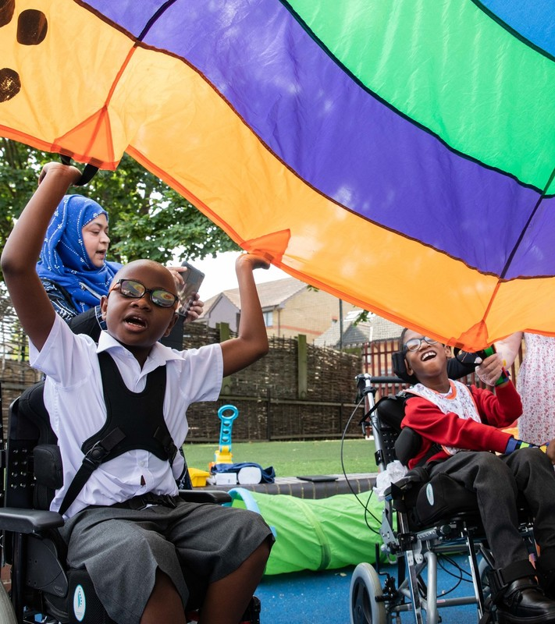
REFLECTION
© UNICEF/Dawe
After this week's discussions, what will be your immediate next steps to ensure your safeguarding procedures are underpinned by articles moving forward? ​
Can you add any of these actions to your current RRSA action plan for the coming academic year?
Notes:
Presenter notes: You could ask people to write down personal commitments in the light of this reflection and collect these in and come back to them at the start of the next term to remind colleagues of their commitment and celebrate any progress.

Slide 14
RESOURCES
You may find the following resources useful for your work on participation:
Safeguarding session from RRSA conference ​
Strengthening Safeguarding through Rights – a list of ideas for bringing rights into your safeguarding work.
Explore Article of the Week packs that link into this month’s Articles
Notes:
Presenter notes: If you have time, please explore these links ahead of your session with colleagues. You may well find a particular resource that you want to highlight to all as part of your input. There may be links you want to share with the team ahead of or as follow up to your input with them.
Encourage your colleagues to explore the RRSA website to find additional resources. If you have time, please explore these links ahead of your session with colleagues. You may well find a particular resource that you want to highlight to all as part of your input. There may be links you want to share with the team ahead of or as follow up to your input with them.

