Slide 1
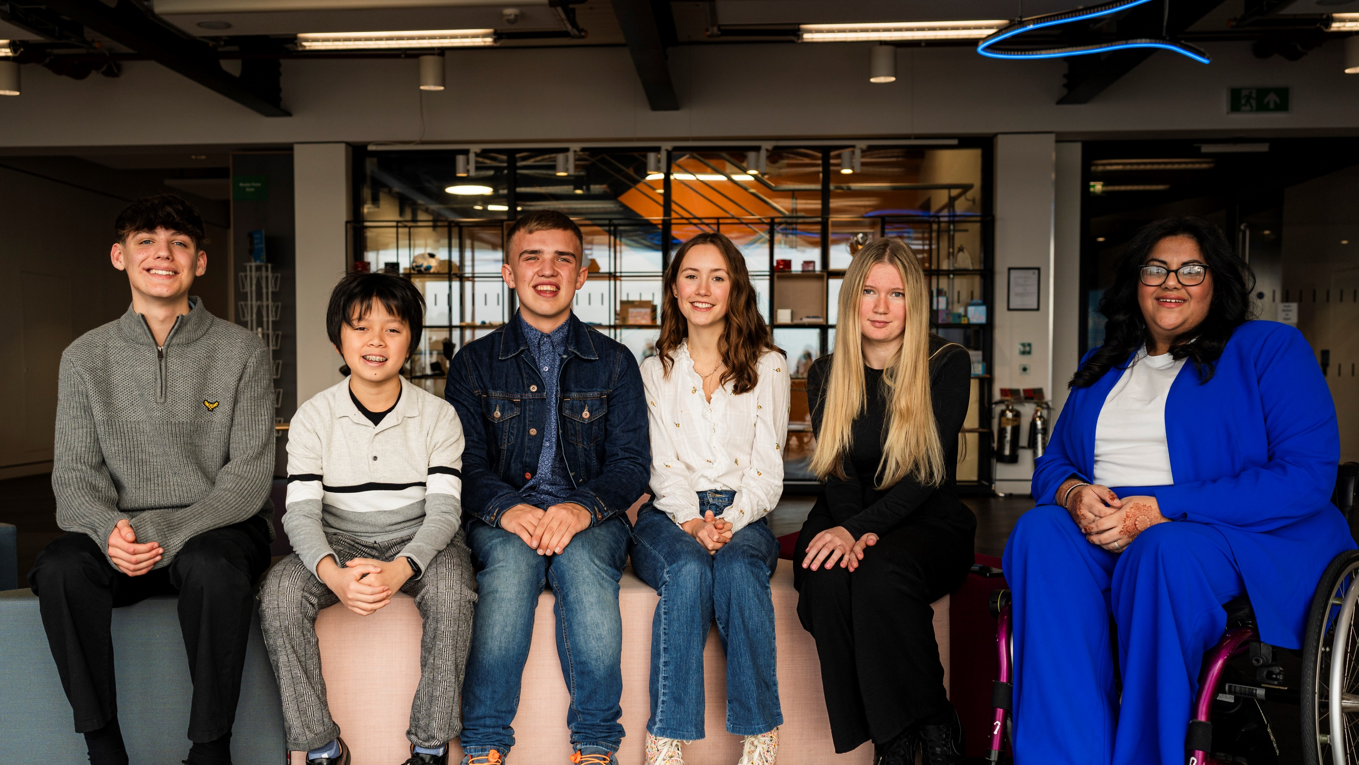
© UNICEF/Dawe
PARTICIPATION
CAMPAIGNING IN SCHOOL
Notes:
Image credit: UNICEFUK/Flynn
The UNICEF UK Youth Advisory Board are a team of young people who help steer the organisational direction of UNICEF UK.
What does the Youth Advisory Board do?
UNICEF UK has had a Youth Advisory Board since 2019. We are influenced by and amplify, their voices on our work and on children’s rights. Members help us by:
- Being a voice on children’s rights
- Providing insight – about what matters to children and young people
Raising awareness – to help other young people understand our work
You can find out more about the Youth Advisory Board here: https://www.unicef.org.uk/working-with-young-people/yab/

Slide 2
CONTENTS
For each slide, please look at the presenter notes for delivery information.
Slide 3: Aims of the Session
Slide 4: Ways to use this pack
Slide 5 : Introducing this month’s Spotlight
Slide 6: Links to RRSA Outcomes
Slide 7: Links to Articles
Slide 8: Case Study – Knowetop Primary School
Slide 9: Case Study - Shenley Fields Daycare and Nursery School
Slide 10 and 11: Let’s Discuss
Slide 12 and 13: Activities
Slide 14: Reflection
Slide 15: Resources
Notes:
For each slide, please look at the presenter notes for delivery information. You may wish to amend or delete this slide when you deliver the session in your school.

Slide 3
AIMS OF THE SESSION
To understand why pupil participation is a key part of becoming a Rights Respecting School.
To identify current practice and opportunities for pupil participation in school.
To discuss how to further develop pupil participation and engagement across all aspects of school life.
Notes:
Presenter notes: Please edit the aims of the session to suit the time you have available for your session.
This session is intended to support you in supporting staff to develop their understanding of what pupil participation is, why it is something that you should be supporting children and young people to engage with as part of your Rights Respecting Schools journey and their role in actively listening to children.
The whole Spotlight series is about embedding children’s rights within a wide range of school priorities and practices. ​
​

Slide 4
WAYS TO USE THIS PACK
DELETE THIS SLIDE BEFORE USING
If your time is tight, use the introduction slide and choose from the key discussion questions to explore with your colleagues.
If you have longer, you can also choose some of the activities to explore.
You may wish to cover the content over several staff meeting sessions.
There are trainer notes for each slide – please do have a look at these for further guidance.
There
Notes:
Delete this slide before using.
It would be useful to have copies of the summary CRC so that staff can refer to them throughout the session.
www.unicef.org.uk/wp-content/uploads/2019/10/UNCRC_summary-1_1.pdf

Slide 5
SPOTLIGHT ON…
We most often associate participation with Article 12, but because this article is one of the four general principles of the convention, it is a theme that should inform all the other rights.
The participation of children and young people is something which sets a child rights approach apart and it is therefore a critical consideration in becoming a Rights Respecting School.
Children and adults need to work together to make genuine participation a reality.
Steven Kidd, Professional Adviser, introduces this month’s Spotlight.
Notes:
The video complements the content of this pack and can also be used separately. ​
​

Slide 6
LINKS TO RRSA OUTCOMES
Strand B: TEACHING AND LEARNING THROUGH RIGHTS
Outcome 7: Children and young people value education and are involved in making decisions about their learning.
SILVER: Many children and young people speak positively of school and of their learning. They understand and can talk about the role they play in their learning. Many adults explain how rights respecting language shapes a positive learning environment.
GOLD: Most children and young people speak of their commitment to the right of others to learn and can describe how they actively respect this right. Nearly all children and young people explain how they play an active role in their learning.
Strand C: TEACHING AND LEARNING FOR RIGHTS
Outcome 8: Children and young people know that their views are taken seriously.
SILVER: Many children, young people and adults describe how young people can express their opinions, have been involved in decisions about their life in school.
GOLD: Most children and young people describe how their participation has a significant impact on school improvement. ​
Notes:
Presenter notes:
This slide provides an opportunity to remind colleagues of the ‘structure’ of RRSA which includes three strands: Teaching about rights; through rights; and for rights.
Participation is linked with both Outcome 7 in Strand B and Outcome 8 in Strand C.
Strand B: TEACHING AND LEARNING THROUGH RIGHTS
Outcome 7: Children and young people value education and are involved in making decisions about their learning.
SILVER: Many children and young people speak positively of school and of their learning. They understand and can talk about the role they play in their learning. Many adults explain how rights respecting language shapes a positive learning environment.
GOLD: Most children and young people speak of their commitment to the right of others to learn and can describe how they actively respect this right. Nearly all children and young people explain how they play an active role in their learning.
Strand C: TEACHING AND LEARNING FOR RIGHTS
Outcome 8: Children and young people know that their views are taken seriously.
SILVER: Many children, young people and adults describe how young people can express their opinions, have been involved in decisions about their life in school.
GOLD: Most children and young people describe how their participation has a significant impact on school improvement.
The full text of the Strands and Outcomes of the Award can be found here:
www.unicef.org.uk/rights-respecting-schools/wp-content/uploads/sites/4/2015/06/RRSA-Strands-and-Outcomes-at-Silver-and-Gold-1.pdf

Slide 7
LINKS TO ARTICLES
Look at the summary of the CRC with a partner – which articles do you think are particularly relevant to our work on PARTICIPATION?
When ready click to reveal.
Although many other articles may also be linked, as participation is a theme running through the whole Convention. It's one of the four general principles.
Notes:
Presenter notes: When showing this slide in presenter mode the articles will appear on click.
Look at the summary of the CRC with a partner – which articles do you think are particularly relevant to our work on participation? Give good time for people to think about and discuss the links. Your colleagues may identify different articles to the ones displayed. If time permits, encourage staff to explain their choices.
CRC Summary: unicef.uk/CRC_Icons

Slide 8
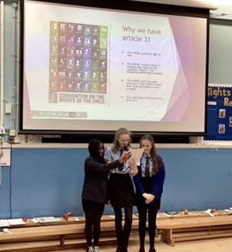
Children presenting at assembly to inform the whole school about rights.
CASE STUDY
Look at this case study from Knowetop Primary School.
Read the full case study online.
​​​​​If you want to improve participation in your school the first thing we would recommend is to speak to the young people in your setting. Ask them directly what they would like to change and how they would like to facilitate change in their own learning environment. The best ideas come from our young people!
​Our children are involved in decision making in all aspects of school life. They can influence curriculum development, changes to the physical environment, playtime activities and extra-curricular opportunities.
Our pupils feel more empowered. We collect data related to our children’s view of themselves and their own health and wellbeing and this has shown that our young people generally have a positive view of themselves as individuals.
Notes:
The full case study is available on the RRSA website, where you can print it out and share with your colleagues if you are choosing to focus on this as part of your session.

Slide 9
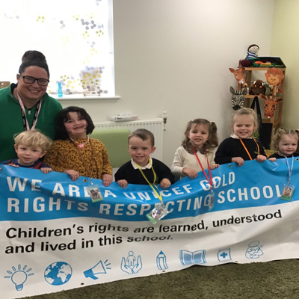
The children's steering group at Shenley Fields with their RRSA Gold banner.
CASE STUDY
Look at this case study from Shenley Fields Daycare and Nursery School.
Read the full case study online.
​​​​​The children’s steering group is at the centre of the decision-making process and all of the children in the school are consulted. They even have their own lanyards they wear to meetings. The group's planning format has been developed to reflect how children learn about their rights and how children’s rights are embedded.
​Shenley Fields entered the Votes for Schools Students Voice Awards. The children and families campaigned because they are not able to access an NHS dental practice. The children received a Special Mention Certificate. This congratulated the children on “Never being too young to use your voice”. Shenley Fields were the youngest children to ever enter the Students Voice Awards.
It’s important for children to feel empowered. It has taken time for us to develop our children’s steering group and to get it right with such young children. The children know that their voices are heard and that they can make a difference.
Notes:
The full case study is available on the RRSA website, where you can print it out and share with your colleagues if you are choosing to focus on this as part of your session.

Slide 10
LET’S DISCUSS
1. Why is it important to include children's voices in school decision making? Discuss in pairs/groups.
2. Consider what you already do that encourages pupil participation, voice and engagement.
3. Reflecting on relevant articles, discuss where you could build in further opportunities for children to be involved in meaningful decision making.
Notes:
Presenter notes: Choose the questions that are most relevant to your setting and experience. Collect some of the ideas from your colleagues and add them to your current action plan/evidence.
Do you have a participation policy or terms of references for pupil groups? If so, these might offer a starting point for discussion. If not don’t worry there are lots or reasons colleagues might share, including: it’s their right, increases engagement, feel valued, empowering, helps understanding of democracy etc. Consider if children don’t get their voices heard – what is their experience? It might be helpful to refer to a copy of the CRC and key articles to support discussion.
Collate ideas from across the school. Class based discussion, pupil groups, clubs, wrap around care, within the curriculum, circle time? How do you ensure all children are heard?
In advance choose relevant articles for your setting to explore with colleagues. For example, you may wish to choose from: Articles 3,12, 13, 15, 23, 24, 28, 29, 31.

Slide 11
LET’S DISCUSS
4. How involved are children in their own learning? What works well in your classroom? What choices do they have?
5. How do you demonstrate to children that you listen to and take their views seriously?
6. “We never dismiss children’s ideas.” Discuss. How can we be clear what aspect of school life young people can influence? What aspects might they not be able to and why?
Notes:
Presenter notes: Choose the questions that are most relevant to your setting and experience. Collect some of the ideas from your colleagues and add them to your action plan/evidence.
4. Discuss these questions in pairs or small groups. Allow colleagues to reflect and then ask for and collate good practice.
5. Give a minute for personal reflection. Request feedback and share good practice examples.
6. Share the questions and provide a narrative to explain it if needed. For example, children’s ideas can lead to learning from exploration, influence the curriculum, create opportunities for discussion, help create boundaries and facilitate research and exploration. There may also be aspects of school life that children can not change, what are these and what should we do when what pupils want is not possible? How can we communicate this respectfully and clearly?

Slide 12
ACTIVITIES
In groups, draw a Rights Respecting classroom onto large pieces of flipchart paper. What do you see, hear and feel in a Rights Respecting classroom?
1. Consider a shared definition and vision for pupil participation in your school. Could this be presented as a charter?
2. Create a timeline to reference the different opportunities children have, to shape their learning and their school.
3. Use The Lundy Model to review current practice and identify areas of development.
Notes:
Presenter notes: There are six suggestions for activities. Depending on the time you have available, choose one or more activities for your colleagues to work on together to further explore the topic. Different groups could explore different activities. The activities that you do not wish to use can be deleted.
Activity 1: Explore with colleagues the full text of Article 12 & 13. Unpick what they mean for children (as rights holders) and adults (as duty bearers) in your setting. Collaborate on a vision that can be shared or use our Charter guidance to structure a pupil voice charter: https://www.unicef.org.uk/rights-respecting-schools/charter-guidance/.
Activity 2: With colleagues think about the experience of a pupil who moves through your setting. Plot all of the opportunities you offer on a timeline. Consider: Do you have circle time? How to pupils in different year groups influence their learning? Are your pupil groups/leadership roles only for certain year groups? What decisions are children engaged in making?
Activity 3: Use the Lundy model guidance document to reflect on practice in your setting. You may choose to do this for your setting or for one or more elements of school life. Use the model findings to then identify key actions needed to strengthen and develop your practice.

Slide 13
ACTIVIES
In groups, draw a Rights Respecting classroom onto large pieces of flipchart paper. What do you see, hear and feel in a Rights Respecting classroom?
4. Identify at least one area in your SIP that children could contribute towards, either through pupil voice groups or as individuals?
5. Learn about participatory budgeting. Could you run something like this in school? Children could vote for projects based on pitches/campaigns (perhaps after a vetting/shortlisting process).
6. We cannot action all children’s ideas.
Reflect on a time when you have had to say ‘no.’
Consider Article 12 and how you could have worked with pupils to explore. Role play...
Notes:
Presenter notes: There are six suggestions for activities. Depending on the time you have available, choose one or more activities for your colleagues to work on together to further explore the topic. Different groups could explore different activities. The activities that you do not wish to use can be deleted.
Activity 4: Have copies of your School Improvement Plan (SIP) ready to share and ask colleagues in small groups to discuss. Consider Article 12 and the age and stage of pupils. Bring groups back to share ideas and then choose one to action to take forward.
Activity 5: Participatory budgeting lets people in a community (in this case your school) decide on how to spend a dedicated budget. How might this work in your establishment? Perhaps your SLT/staff team could identify 3 possible ways to spend a small budget and then support the pupils to decide on which is chosen; this could involve research on the relative benefits, teams to champion each ‘project’ and a school-wide vote. If you want to make it even more participative, you could help the children come up with the ideas for the projects, too.
Activity 6: In small groups identify a recent issue or change children were vocal about but that could not be actioned. Role play different scenarios and outcomes. Explore how the discussion could be a learning opportunity. Share how each party might fell in the different scenarios. Celebrate your good practice and reflect on any changes you can make in your approach next time you need to say ‘no.’
*The Problem and Solution Tree can be found on pages 8 & 9 of the Youth Advocacy Toolkit. You find the pdf and print from here: https://downloads.unicef.org.uk/wp-content/uploads/2019/03/Youth-Advocacy-Toolkit.pdf

Slide 14
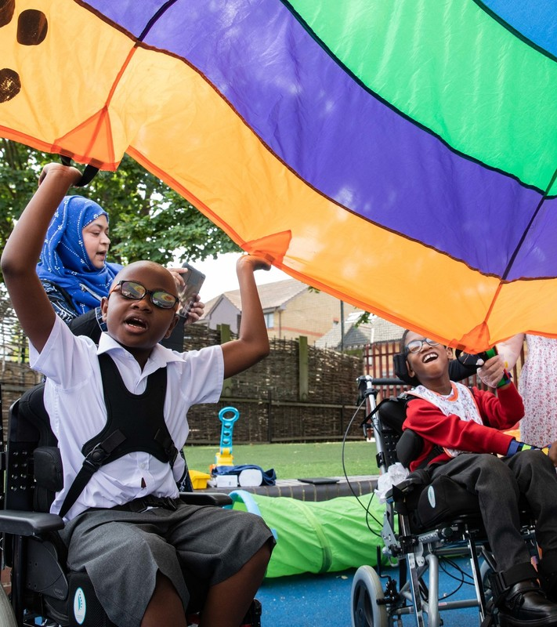
REFLECTION
© UNICEF/Dawe
What ONE thing could you do in your role to ensure every child’s voice is heard and taken seriously?
What ONE thing could the school do collectively to support children's voice and participation?
Notes:
Presenter notes:
Ask people to write their personal commitments and ideas for school’s action on post its. Display these and identify themes and/or ask individuals to elaborate on their ideas.
Keep or record these and come back to them at the start of the next term to remind colleagues of their commitment and celebrate any progress.
Personal commitments may be kept private if more appropriate however do still consider revisiting to celebrate progress and impact.

Slide 15
RESOURCES
You may find the following resources useful for your work on participation:
Youth Advocacy Toolkit
UNICEF UK’s OutRight Campaign
Steering group guidance
Charter Guidance
Have you heard of VotesforSchools? Each week, their topical resources are directly linked to the CRC articles. What's more, they have a voting platform that helps to amplify the voices of children & young people, both in school and beyond.
The Lundy Model: Article 12 in Practice
UNICEF UK’s RRSA Team provide training which may be of use to you or colleagues:
Strengthening Participation workshop
There are many models of participation that will help you explore pupil participation further such as:
More information about The Lundy Model
Notes:
Presenter notes: If you have time, please explore these links ahead of your session with colleagues. You may well find a particular resource that you want to highlight to all as part of your input. There may be links you want to share with the team ahead of or as follow up to your input with them.
Encourage your colleagues to explore the RRSA website to find additional resources. If you have time, please explore these links ahead of your session with colleagues. You may well find a particular resource that you want to highlight to all as part of your input. There may be links you want to share with the team ahead of or as follow up to your input with them.

