Slide 1
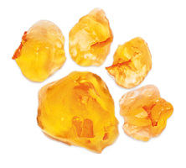

Slide 2
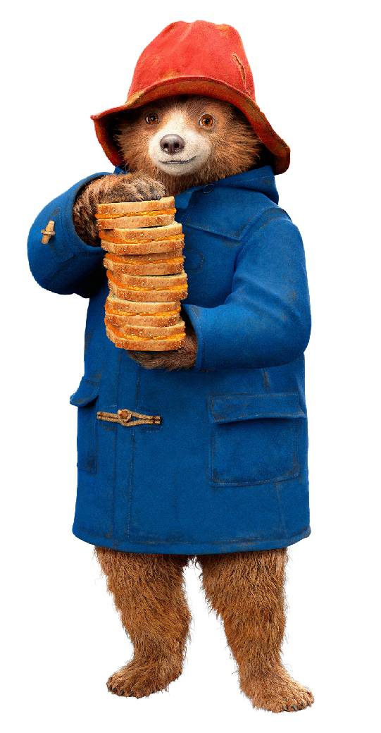
Paddington Bear was raised by his Aunt Lucy in the jungle of Darkest Peru. As a young cub Paddington learned many things from them – like how to speak English, and how to make marmalade.
What else do you think that Paddington may have learned from Aunt Lucy?

Slide 3
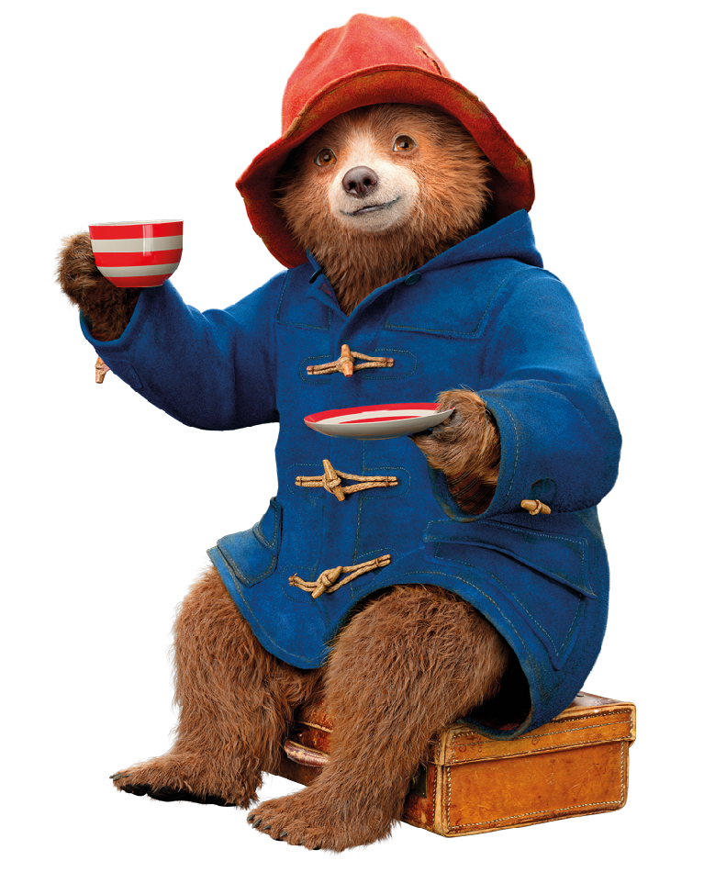
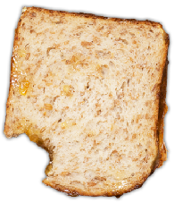
Can you imagine if you and Paddington went to visit his Aunt Lucy in Peru for a cup of tea and a marmalade sandwich?
What do you think we might be able to learn about how their jungle changed over time?
What questions would you ask them?

Slide 4
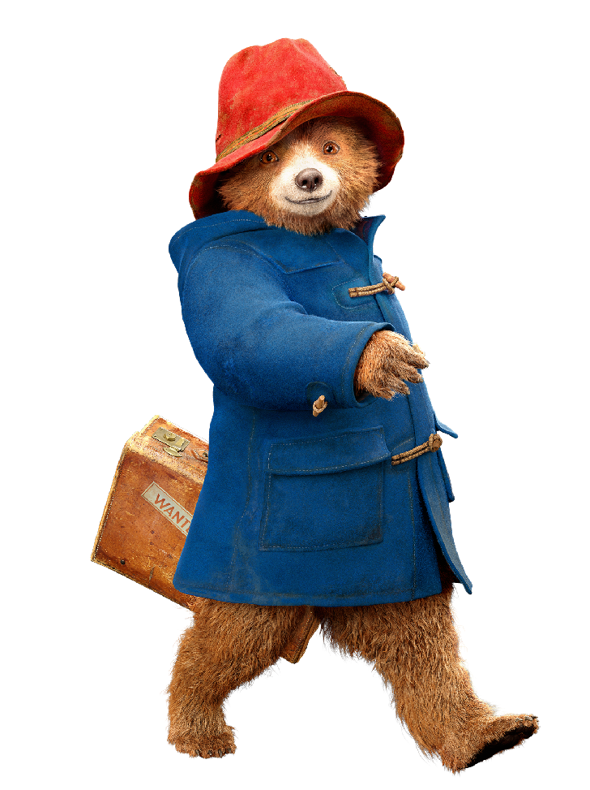
In this activity, we are going to explore what we can learn from the adults in our community about climate change and the changes that they have seen in their own lifetimes.

